Slide 1


Kensington Public Safety Building: Potential Impact of Future Renovation on KPD
Walt Schuld, Interim Chief of Police
Marti Brown, General Manager
KPPCSD

Slide 2
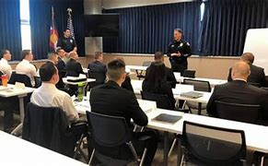
AGENDA
Existing Building Footprint
Proposed Renovated Building Footprint
Possible Future Challenges
Contracting for Services
Modeling the Potential Future Lease Rate (Plan G)
Thinking “Outside the Box”
Next Steps

Slide 3
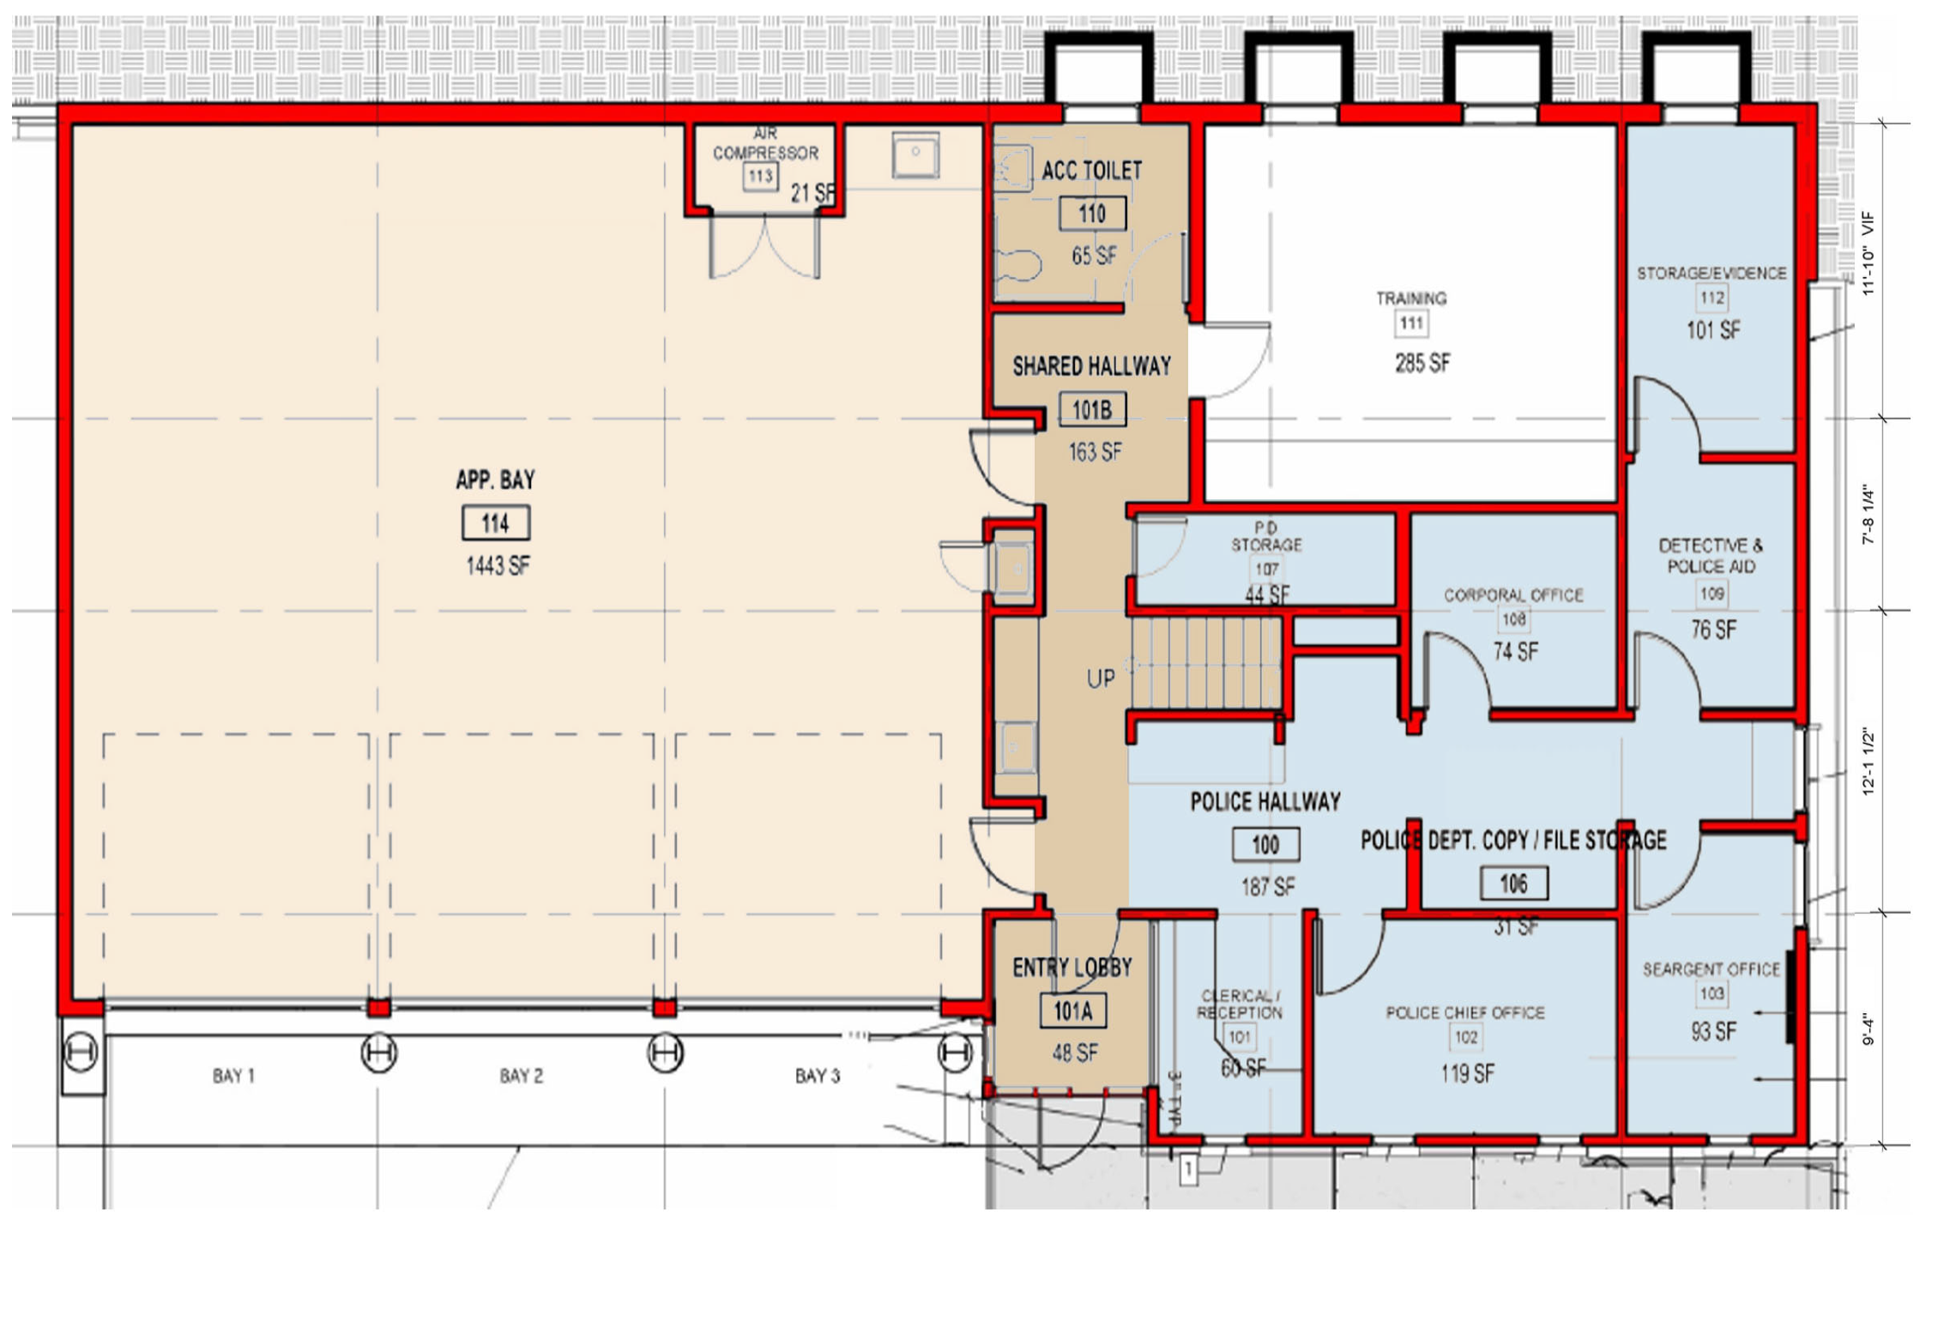
Existing Floor Plan
1st Floor
Total Area - ~ 785 square feet
Chief’s Office - 119 square feet
Sgt. Office - 74 square feet
PSA/Captain Office - 76 square feet
Det. Sgt. & TSO Office - 93 square feet
Evidence Room - 110 square feet
Lobby/Reception - 60 square feet
Storage - 44 and 31 square feet
Shared Conference Room - 220 square feet
Notes:
Blue is PD, light brown his Fire, and dark brown is shared

Slide 4
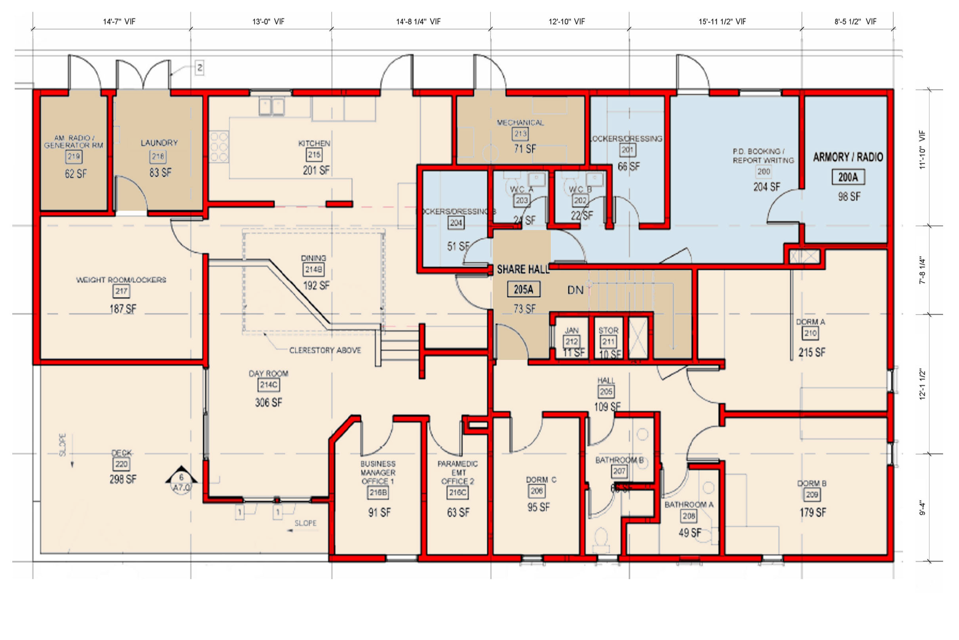
Existing Floor Plan
2nd Floor
Total area - ~ 441 square feet
Armory/Radio Room
- 98 square feet
Booking/Report Writing Room - 204 square feet
Two locker rooms - 68 and 51 square feet
Restroom - 66 square feet
Total square footage (1st & 2nd floor) - 1226 square feet
Notes:
Again Blue is PD, light brown is Fire and Dark Brown is shared.

Slide 5
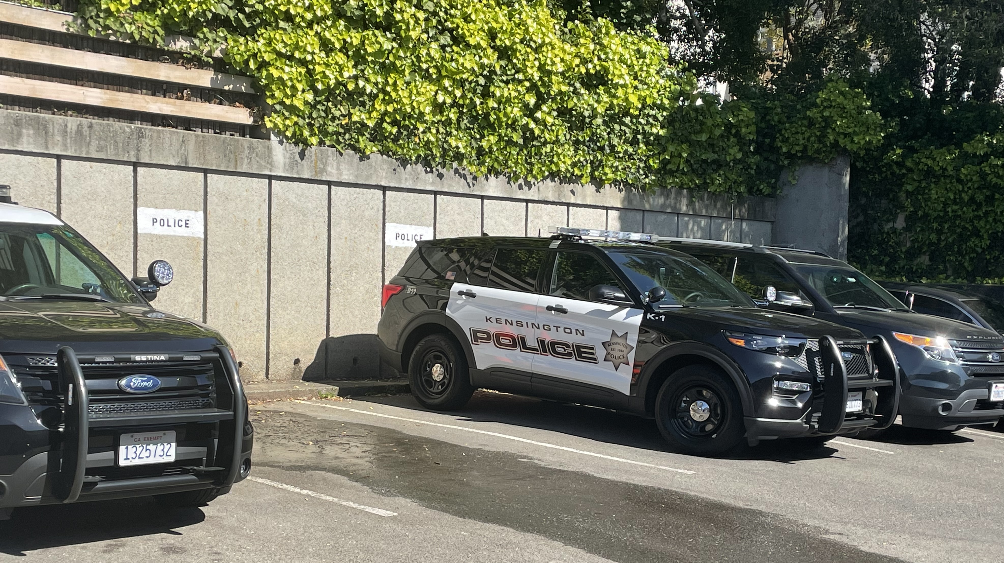
Existing District
Vehicle Parking
7 KPD Vehicles
6 Parking Spaces
1 Vehicle parks on Arlington Avenue
Personal vehicles of employee's park on Arlington Avenue
Notes:
Parking issues are sometimes inconvenient but are not a problem

Slide 6
Proposed Plan G
1st Floor
Notes:
Blue is PD, light brown his Fire, and dark brown is shared

Slide 7
Proposed Plan G
2nd Floor
Notes:
Blue is PD, light brown his Fire, and dark brown is shared

Slide 8
Proposed Plan G
KPD 1st Floor
Total area - ~ 650 gross square feet
Lobby/Reception
Chief & Captain Offices
Locker Room
Armory/Radio Room
Joint Conference Room

Slide 9
Proposed Plan G
KPD 2nd Floor
Total area – ~ 378 gross square feet
Computer Room
Booking & Cuffing
Patrol Officers’
work area

Slide 10
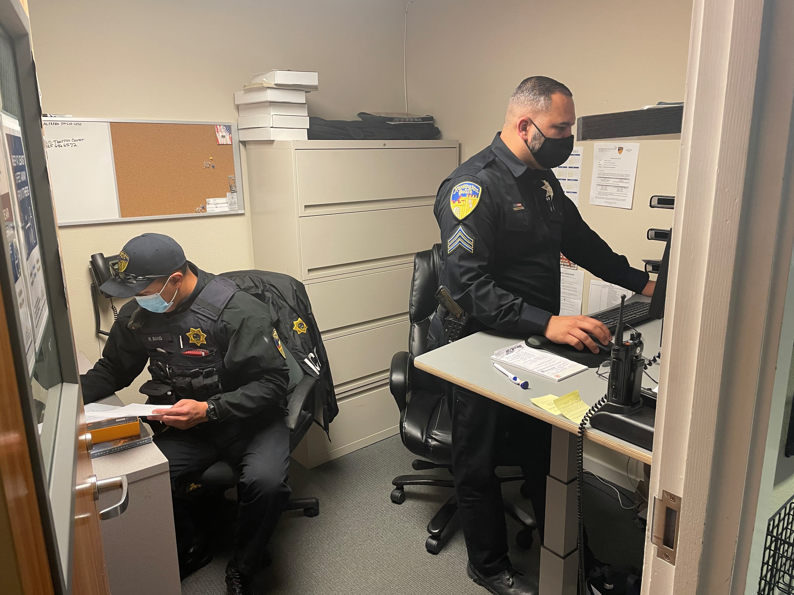
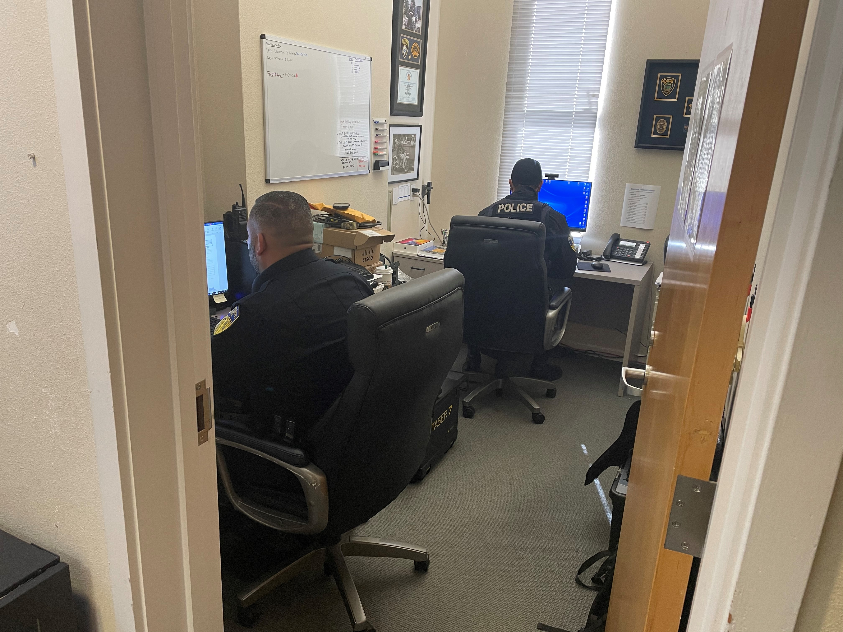
Proposed Plan G
^{What’s missing?}
No Office Space for the Police Services Assistant.
No office space for the Traffic Safety Officer.
No office space for two Sergeants.
No office space for a Detective.
No evidence Room or temporary storage lockers for evidence.

Slide 11
Contracting
for Services
Detective Services - Availability & Potential Cost:
Four agencies contacted – not interested in contracting for detective services.
If they were interested, however, they would charge ~ 50% of the total “roll up” cost of a detective's employment (e.g., salary and benefits) based on the District’s workload.
Based on this calculation, the District would pay ~ $80,000-150,000 per year for detective services.
Even after this expense, there are still auxiliary duties that would not be accounted for and/or could not be delegated to the contract Detective; and would have to be absorbed by another non-contract officer.

Slide 12
Contracting
for Services
Detective Services – Example of Types of Crime Investigated
Violation of Court Orders, Domestic Violence – Felony, Domestic Violence – Misdemeanor, Negligent Discharge of Firearms, Elder Abuse, Criminal Threats, Burglary, Grand Theft, Petty Theft, Identity Theft, Vandalism, Trespassing, Stalking, Stolen Vehicles, and Traffic Collision.
Detective Services – Time Spent on Investigations in Kensington
On average and in Kensington, a Detective is the primary investigator on two cases per week; and assists and/or provides direction to other Officers on another 10 incidents per week. Any given week there are approximately a dozen cases or incidents being investigated. In 2020, there were a little more than 230 cases and approximately 9,000 incidents investigated.

Slide 13
Contracting for Detective Services – Unfulfilled Duties
Auxiliary Duties:
Verizon Wireless Contract
Cisco Router Research and Purchase Options
Coordinate Bidding Process for install
Coordinating Verizon switchover and Install
Communications Coordinator
Agency Administrator to JAWS
Agency Administrator to ewarrants through Contra Costa County
Agency Administrator to DOJ for CalPhoto
Agency Administrator to CSAR
(California Sex and Arson Registry)
Auxiliary Duties (Cont.):
Agency Administrator to CLETS
(California Law Enforcement Telecommunications System)
Agency Administrator to Contra Costa Mobile Identification System
Agency Administrator to CLEW
(California Law Enforcement Web)
Agency Administrator to BAR
(Bureau of Automotive Repair)
Agency Administrator to FTO
(Field Training Officer) Program through POST (Peace Officer Standards and Training)

Slide 14
Contracting
for Services
Evidence Storage:
No jurisdiction in Contra Costa County
is willing to contract and store District evidence.
Both DDA and Sheriff’s Offices have serious concerns regarding chain of custody and proper management of evidence when two separate agencies are handling the same evidence for one jurisdiction.
Should a case be presented at trial, the Public Defender would likely raise an issue in most evidentiary cases.

Slide 15
Purpose & Function
of Evidence Room
& Technician
Ensure chain of evidence and custody.
Ensure property packing and marking of evidence.
Meticulously record incoming and outgoing evidence.
Return evidence from crime labs to evidence room.
Review Evidence Reports for accuracy and return to officers for any corrections.
Oversee department compliance with evidence policies and procedures.
Perform Evidence Room Audits to ensure compliance with evidentiary policies and procedures; and post audit results.
Maintain evidence supplies and arrange for replenishment.
Properly purge evidence after detailed research
of cases.
Administer DOJ CHOP & SAFE-T.
Administer DOJ NIBRS
(National Incident-Based Reporting System).
Coordinate submission and reporting of Aries Lab Results.
Adjudicate cases: Safekeeping, Evidence, and Found Property.
Collect evidence sheets.
Marry evidence sheet with evidence in temporary lockers.
Remove evidence from temporary lockers.
Transfer evidence to the Evidence Room.
Complete chain of custody.
Place items in designated areas in Evidence Room.
Facilitate the transport and chain of custody of evidence to Crime Labs.
Ensure chain of custody is complete between evidence property technician and officer.

Slide 16
Contracting
for Services
Traffic Safety Officer (TSO) - Duties:
Review all Traffic Accidents and ensure that they meet State Guidelines.
Investigates hit & Run Accidents.
Send reports to the State and the County.
Respond to major injury accidents.
Enforce traffic laws.
Identify and enforce traffic “Hot Spots” and direct other officers to those areas.
Draft traffic grants.
Identify traffic related problems (e.g., signs, intersections, and parking).
Liaison with County Public Works to install signs and deal with road conditions.
Liaison with community on parking related issues.
Update collision Investigation Manual.
Develop and revise traffic related forms.
Liaison with the Traffic Court Commission.
Act as District’s Community Service Officer.
Oversee Evacuation Route Improvement Planning/Disaster Preparedness.

Slide 17
Contracting
for Services
Traffic Safety Officer – Availability & Potential Cost:
Most jurisdictions are short staffed and it is unlikely that any nearby public safety agency would be interested in contracting for services.
Should the District be able to find a local jurisdiction to provide traffic safety services, the “roll up” cost (including salary, benefits and administration of the contract) would likely exceed the cost of maintaining the full-time position within the KPD.

Slide 18
Contracting
for Services
Public Services Assistant – Duties:
Manage evidence regulation compliance with evidence regulations.
Ensure compliance with POST and other Legislative Mandates.
Schedule Officer Trainings.
Manage KPD Records.
Record and report monthly police statistics.
Schedule and manage Community Center and other park facility rentals.
Coordinate parks and facilities maintenance and special projects.
KPD Accounts Receivable.
Complete other special projects as assigned.

Slide 19
Contracting
for Services
Public Services Assistant – Availability & Potential Cost:
Most jurisdictions are short staffed and it is unlikely that any nearby public safety agency would be interested in contracting for these services.
Should the District be able to find a local jurisdiction to provide the same duties as the Public Services Assistant position, the “roll up” cost (including salary, benefits and administration of the contract) would likely exceed the cost of maintaining the current part-time position, especially since in any other jurisdiction, the PSA would be a full-time, CalPERs employee.

Slide 20
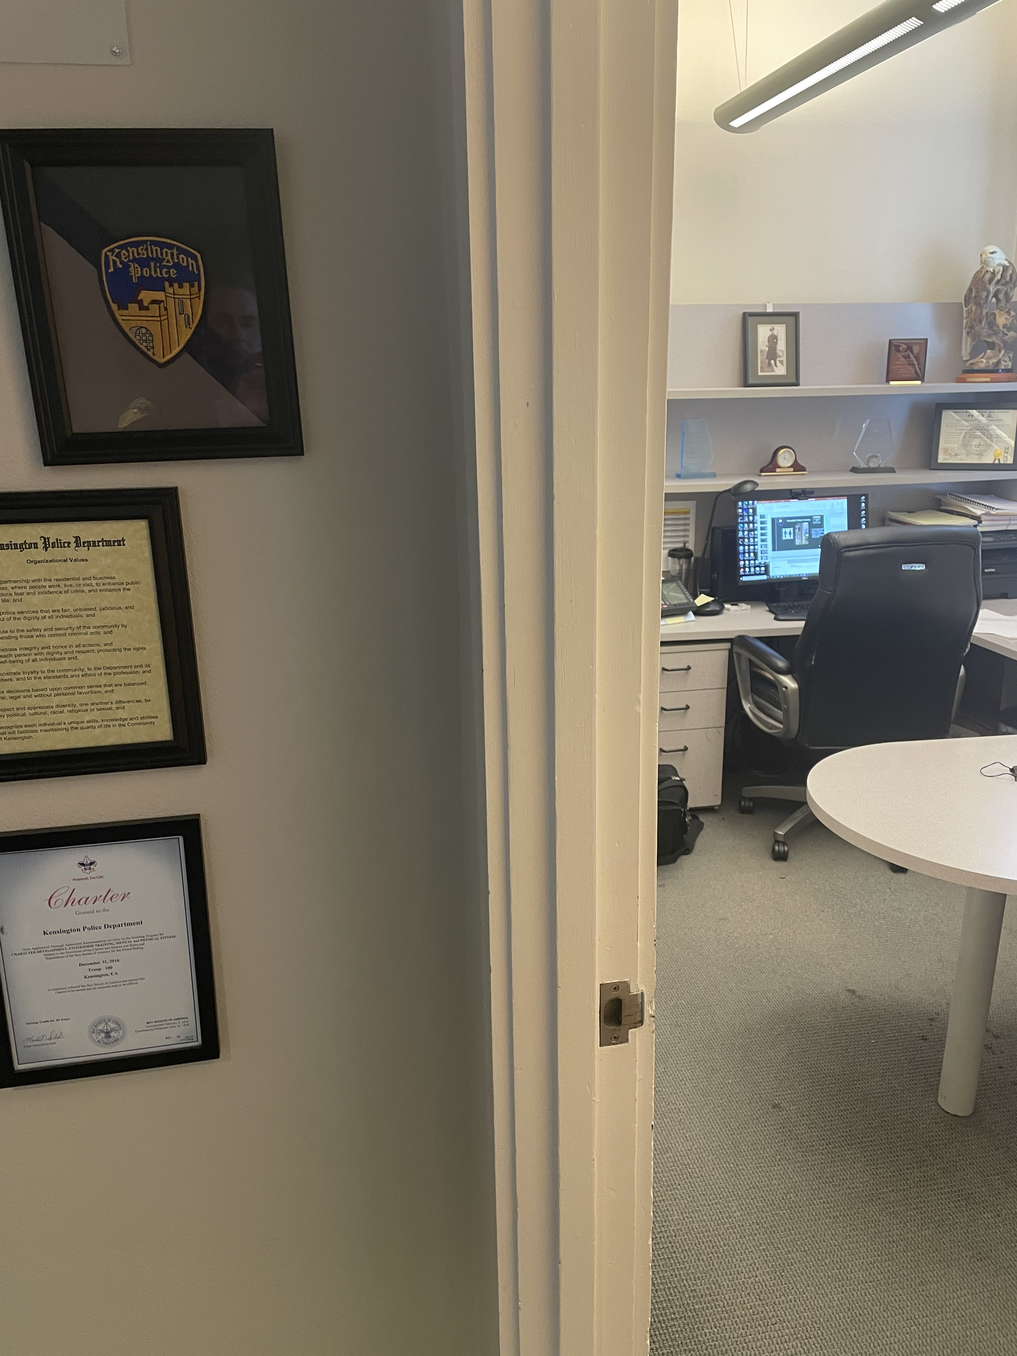

Other Possible
Future Challenges
Unisex locker room and bathroom
May lose an additional 150 square feet due to restroom regulations and unclear wall thickness of conceptual design
Notes:
We lose a bathroom and live scanning capabilities although we may be able to squeeze in the machine once the square footage is known.
Currently, the drawings and various schematics, including Plan G are conceptual. Typically, exact square footage of a project isn’t known until 70% or more of construction drawings have been complete. So, the exact net square footage for the KPD space is not yet known and won’t be until the construction drawings are complete.

Slide 21
Modeling – Potential Future Lease Rate
How did the KPPCSD come to pay $3050 per month for its space in the PS Building?
If we use the past precedent to calculate the lease rate of a newly renovated PS Building and the KPPCSD’s potential 1020 square feet (Plan G), what would the new lease rate look like?
Based on past precedent, the lease rate for newly renovated 1020 square feet in the PS Building would be $8750 per month.
Calculation:
1020 square feet/5800 square feet = 17.5% (of the total space)
17.5% x $6 million = $1,050,000
$1,050,000/120 months (or 10 years) = $8750/month
Source: Everything You Wanted to Know About the Public Safety Building But Were Afraid to Ask, Kensington Outlook, March 2010;
and Letter from GM Hansell with supporting documentation, April 1, 2021 (attached to this agenda item).

Slide 22

Thinking
“Outside the Box”
Contract to store files in outside facility.
Expeditiously digitize all files that do not require maintaining a hard copy.
Locate 2nd Office in Community Center for PSA, TSO and Sergeants.
Close lobby and conduct business by phone and email.

Slide 23
Next Steps?
Direct GM to:
Discuss and negotiate terms (including financing) with Fire District GM for permanent space in the PS Building based on Plan G.
Explore options to lease permanent or temporary relocation space, including long-term financial impact analysis and financing options.
Explore options to purchase land and construct a new building for KPPCSD;
or work with KFPD to explore options for a joint PS Building.
Explore options for cutting services (facilitating KPD’s ability to better fit in the newly renovated PS Building).

Slide 24

Questions?

